Slide 1
Change My View
or
Finding Conversational Styles Other Than “Stubborn” on Reddit
John Gilling
TL;DR

Slide 2
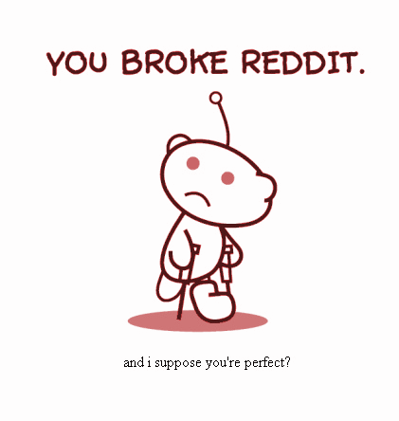
Why?
The internet is full of useful resources, but message boards are notorious for being homogeneous and hostile to outside individuals and different ideas.
/r/changemyview is a forum designed for individuals sick of the monoculture and looking for challenges to their beliefs.
It’s a microcosm that represents a slice of rational conversation on the internet and in real life.

Slide 3

How does it work?
SUBTEXT:
However, I’d be willing to change my view after a balanced discussion representing both sides of the matter. Someone please present an opposing opinion!
POST:
I THINK THAT PRESIDENT OBAMA IS A DIRTY SO-AND-SO!
OP (original poster)
RESPONSE:
NO WAY HE’S GREAT!
Comment 1
RESPONSE:
HERE’S SOME DATA SHOWING HE’S ACTUALLY DOING A GREAT JOB.
Comment 2
END RESULT:
Wow, I hadn’t thought of it that way; now that I do, the other side of this argument makes sense to me. ∆
OP again

Slide 4
Methodology
Kaggle Reddit Data (May 2015 Comments)
PRAW (Python Reddit API Wrapper)
Search for /u/DeltaBot responses
NLTK for tokenizing, removing stop words, and lemmatizing
Gensim for LDA Model and Similarity Measurements
Flask and D3 for Visualization

Slide 5
LDA TOPIC RESULTS
k = 2 (number of topics):
0.012*people + 0.008*would + 0.007*it's + 0.007*get + 0.007*don't + 0.006*like + 0.006*one + 0.006*make + 0.005*think + 0.005*thing
k = 50 (number of topics):
'0.030*job + 0.021*money + 0.020*pay + 0.018*would + 0.013*people + 0.013*tax + 0.013*work + 0.012*government + 0.012*company + 0.012*cost'
k = 100 (number of topics):
0.068*robot + 0.024*would + 0.021*strong + 0.016*release + 0.012*beneficial + 0.011*destroyed + 0.011*perfect + 0.011*feasible + 0.011*mission + 0.010*could

Slide 6
TO THE APP!
Change My View!

Slide 7
You can also split your content
White
Is the color of milk and fresh snow, the color produced by the combination of all the colors of the visible spectrum.
Black
Is the color of coal, ebony, and of outer space. It is the darkest color, the result of the absence of or complete absorption of light.

Slide 8
In two or three columns
Yellow
Is the color of gold, butter and ripe lemons. In the spectrum of visible light, yellow is found between green and orange.
Blue
Is the colour of the clear sky and the deep sea. It is located between violet and green on the optical spectrum.
Red
Is the color of blood, and because of this it has historically been associated with sacrifice, danger and courage.

Slide 9
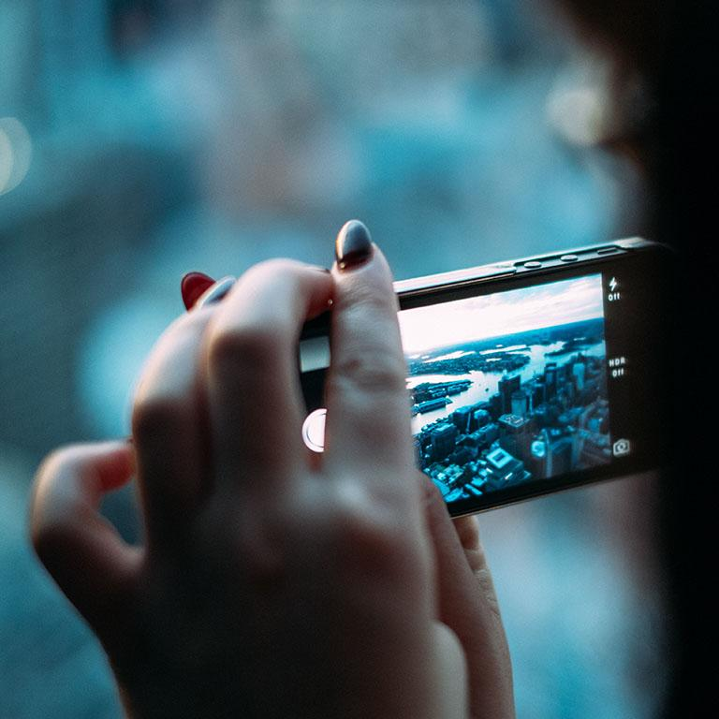
A picture is worth a thousand words
A complex idea can be conveyed with just a single still image, namely making it possible to absorb large amounts of data quickly.

Slide 10
Want big impact?
Use big image

Slide 11
Use charts to explain your ideas
White
Gray
Black

Slide 12
And tables to compare data
 | A | B | C
Yellow | 10 | 20 | 7
Blue | 30 | 15 | 10
Orange | 5 | 24 | 16

Slide 13
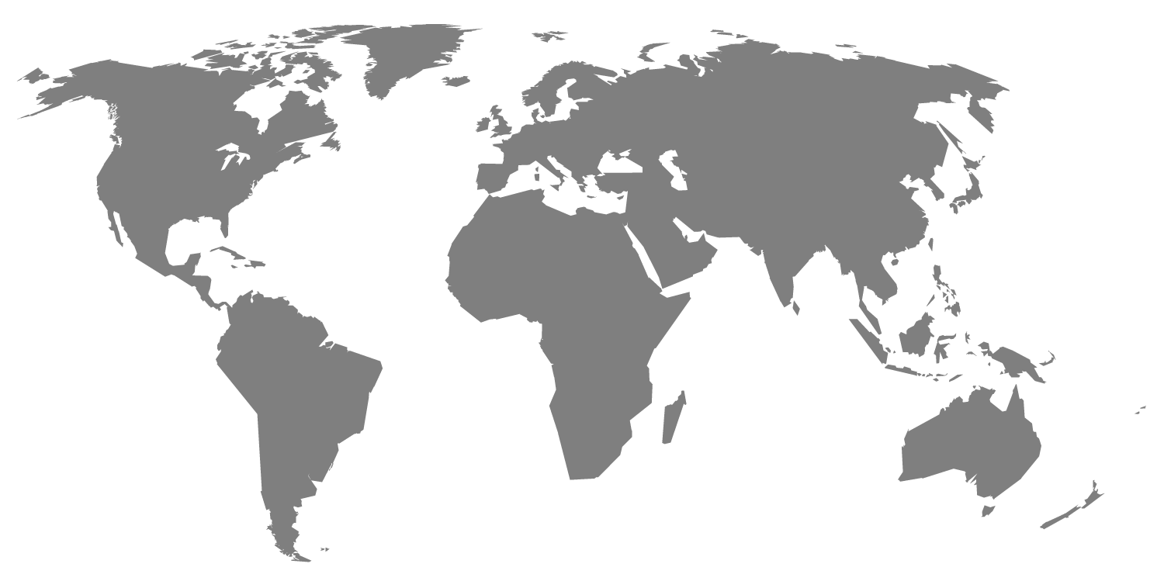
Maps
our office

Slide 14
89,526,124
Whoa! That’s a big number, aren’t you proud?

Slide 15
89,526,124$
185,244 users
100%
That’s a lot of money
And a lot of users
Total success!

Slide 16
Our process is easy
first
second
last

Slide 17
Let’s review some concepts
Yellow
Is the color of gold, butter and ripe lemons. In the spectrum of visible light, yellow is found between green and orange.
Blue
Is the colour of the clear sky and the deep sea. It is located between violet and green on the optical spectrum.
Red
Is the color of blood, and because of this it has historically been associated with sacrifice, danger and courage.
Yellow
Is the color of gold, butter and ripe lemons. In the spectrum of visible light, yellow is found between green and orange.
Blue
Is the colour of the clear sky and the deep sea. It is located between violet and green on the optical spectrum.
Red
Is the color of blood, and because of this it has historically been associated with sacrifice, danger and courage.

Slide 18
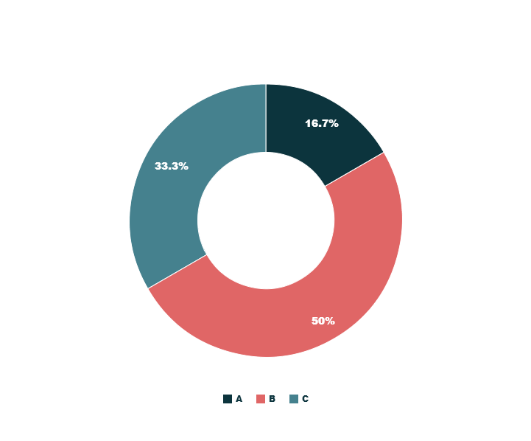
You can copy&paste graphs from Google Sheets

Slide 19
Android project
Show and explain your web, app or software projects using these gadget templates.
Place your screenshot here

Slide 20
iPhone project
Show and explain your web, app or software projects using these gadget templates.
Place your screenshot here

Slide 21
Tablet project
Show and explain your web, app or software projects using these gadget templates.
Place your screenshot here

Slide 22
Place your screenshot here
Desktop project
Show and explain your web, app or software projects using these gadget templates.

Slide 23
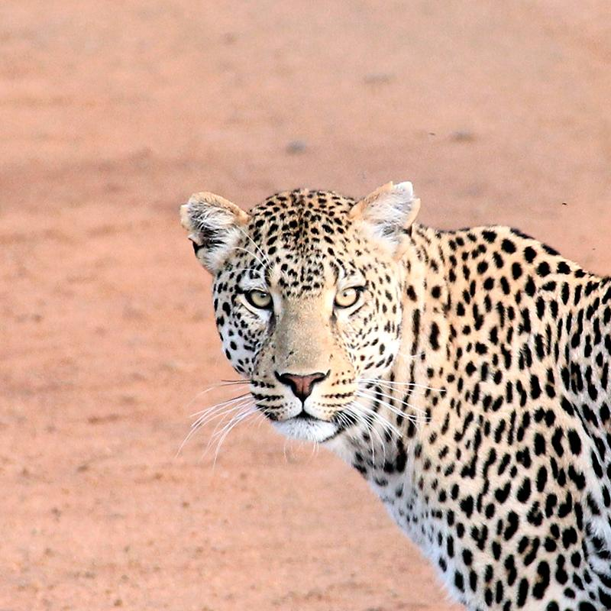
Thanks!
Any questions?
You can find me at:
@username
user@mail.me

Slide 24
Credits
Special thanks to all the people who made and released these awesome resources for free:
Presentation template by SlidesCarnival
Photographs by Unsplash

Slide 25

Presentation design
This presentations uses the following typographies and colors:
Titles & body copy: Source Sans Pro
You can download the fonts on this page:
https://www.google.com/fonts#UsePlace:use/Collection:Source+Sans+Pro:400,700,400italic,700italic
Click on the “arrow button” that appears on the top right
Dark gray #2f3848
Turquoise #00c5b9
Salmon #f05768
You don’t need to keep this slide in your presentation. It’s only here to serve you as a design guide if you need to create new slides or download the fonts to edit the presentation in PowerPoint®

Slide 26
SlidesCarnival icons are editable shapes.
This means that you can:
Resize them without losing quality.
Change fill color and opacity.
Change line color, width and style.
Isn’t that nice? :)
Examples:

